Slide 1

Phonetics and Phonology
(Natural Language Processing)
HND Thilini
hnd@ucsc.cmb.ac.lk

Slide 2
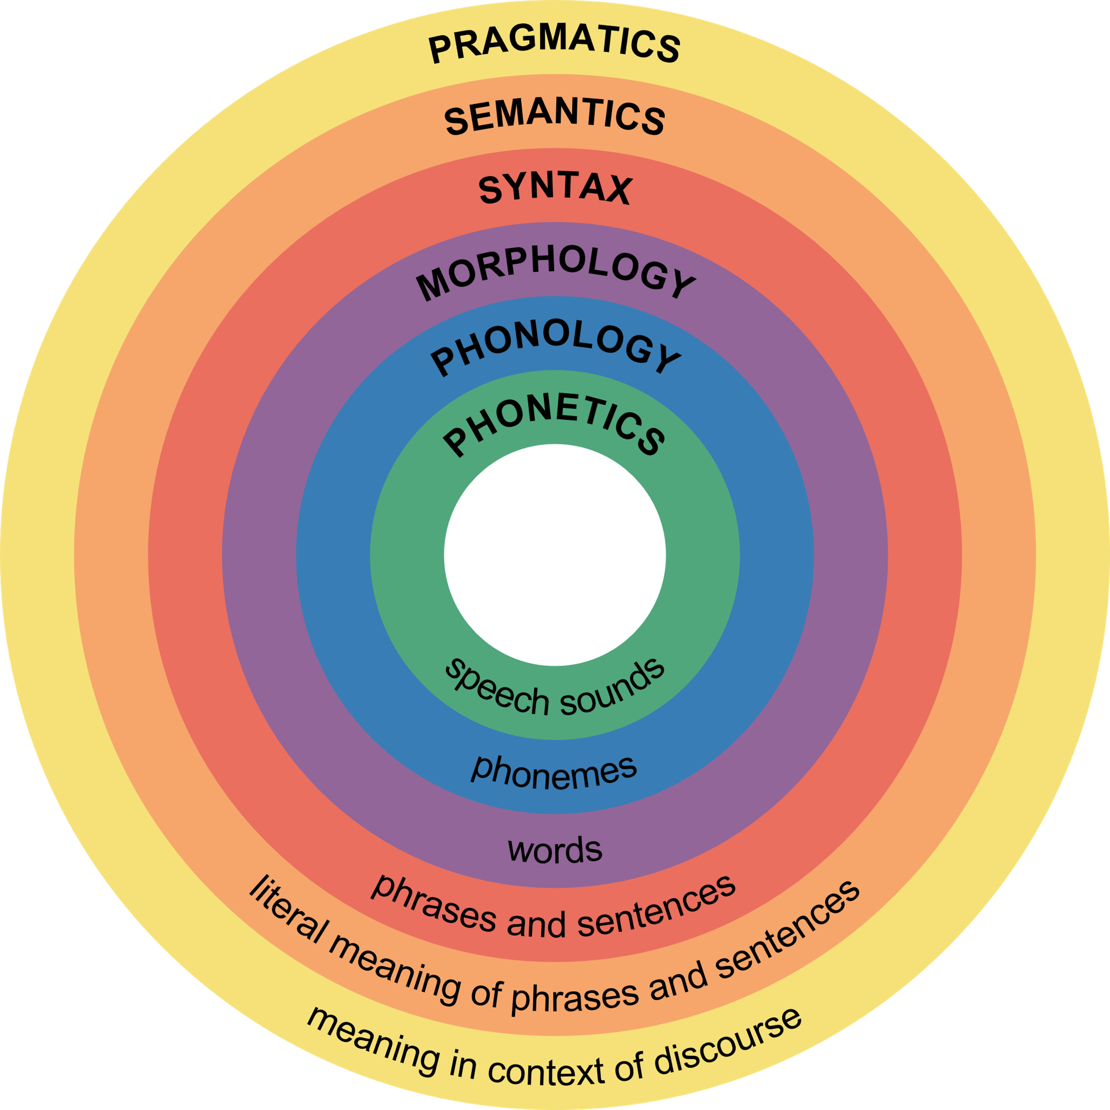
Major Levels of Linguistics
2
Notes:
These are the major levels of linguistics or sometimes we called knowledge about language.
Still very limited researchers are done some research related to the Semantics and Pragmatics.

Slide 3
Phonetics
The suffix -phone- is used in English, to denote words which are sound related
e.g. microphone, telephone
The suffix -tics means ‘study of’, ‘art of’, ‘science of’ or technique
e.g. mathematics, optics, statistics
phonetics
3
Notes:
Optics is the branch of physics that studies the behaviour and properties of light

Slide 4
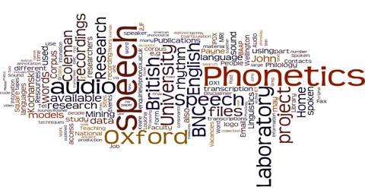
Definition
Phonetics is the study and classification of speech sounds used in the languages of the world.
What is Speech?
How speech is being produced?
4

Slide 5
What are
Speech Sounds?
5

Slide 6
What are Speech Sounds???
A
Set A
Set B
Set C
6
Notes:
Here you can see three sets A, B and C.

Slide 7
What are Speech Sounds???
Set A
All sounds in the universe.
7
Notes:
Lets say Set A consists all sounds in the Universe. However, I think all of you know that, Humans cannot hear all the sounds. We 20 Hz == 20,000 Hz
Dogs can hear up to 45KHz (higher frequencies)
Only a subset of Set A can hear by the humans.

Slide 8
What are Speech Sounds???
A
Set A
Set B
All the Sounds that human can hear
8
Notes:
Set B is the all sounds that human can hear. But all of those sounds are not human sounds
Only some of those sounds are used in languages

Slide 9
What are Speech Sounds???
A
Set A
Set B
Set C
All Language Sounds
9
Notes:
Set C: Set C consists all Language Sounds
All languages spoken around the world

Slide 10
What are Speech Sounds???
Set C
English
Tamil
Sinhala
10

Slide 11
Phonology?
The suffix -logy means the ‘systematic study of’
e.g. biology, zoology
phonology
11
Notes:
Features specific to their language
Sinhala has a separate phonology

Slide 12
Phonology
How we understand?
How our brain process speech?
Grammar of speech!
Definition
Phonology is the area of linguistics that describes the systematic way that sounds are differently realized in different context/environments and how this system of sound is related to the rest of the grammar
12
Notes:
Again you need to understand Phonetics is the study of speech sounds
Phonology studies how languages systematically organize their sounds.
Sinhala has spelling rules – word with ‘ra’ next character ‘na’ should be murthaja - raNa

Slide 13

Grammar of Speech
Eg: ලිප් ගල්
ල්= /l/
ඉ = /i/
ප් = /p/
ග්= /g/
අ = /a/
ල්= /l/

Slide 14
Grammar of Speech
Eg: ලිප් ගල්
ල්= /l/
ඉ = /i/
ප් = /p/
ග්= /g/
අ = /a/
ල්= /l/
උක් ගස්, අත් දිග

Slide 15
Phonetics vs Phonology
Phonetics deals with the production of speech sounds by humans, often without prior knowledge of the language being spoken.
What are the sounds? How are they made in the mouth?
Phonology is about patterns of sounds, especially different patterns of sounds in different languages, or within each language, different patterns of sounds in different positions in words etc.
How do sounds combine? How are they memorized?
Notes:
Sinhala Sounds

Slide 16
Speech Sounds
ල්, ல் = /l/
ග්, க் = /g/
ඉ, இ = /i/
ප්, ப் = /p/
අ, அ = /a/
Notes:
These sounds are we called speech sounds. You will see these sounds are in English and tamil also.
Sinhala අැ tamil no ae
Natve English Speaker and Non – Native English Speakers , USA and UK

Slide 17


Speech Sounds
ල්, ல் = /l/
ග්, க் = /g/
ඉ, இ = /i/
ප්, ப் = /p/
අ, அ = /a/
Bath
Advertisement
Chance
Class
Notes:
These sounds are we called speech sounds. You will see these sounds are in English and tamil also.
Sinhala අැ tamil no ae
Natve English Speaker and Non – Native English Speakers , USA and UK
You speak according to the sound set you have.
Japan Road → Load (Different set of Sounds)

Slide 18
Speech Sounds
Phone:
The smallest sound unit of speech
ප්[p] (phone)
Phoneme:
The smallest unit of speech that affects the meaning of a word.
(phone) [p]
/p/ (phoneme)
(phone) [p^{h}] (ඵ)
Notes:
Three concepts you need to understand well. Ba is produced with b and a
A phone is the most basic unit of speech sounds (Any sound generated from human mouth) .
the word bat begins with the [b] phone. It has three distinct sounds: the b sound, the a sound, and the t sound. The four-letter word ball has only three phones: the b sound, the a sound, and a single l sound.
A phoneme can be defined as the smallest unit of sound in a language that distinguishes one word from another. In the word "cat," for example, there are three phonemes: "c," "a," and "t." If we change the first of these phonemes from "c" to "h," then we'd have a different word, "hat" instead of "cat.“
Phoneme is a subset of phone.

Slide 19
Phone vs Phoneme
In phonetics and linguistics, a phone is any distinct speech sound or gesture, regardless of whether the exact sound is critical to the meanings of words.
In contrast, a phoneme is a speech sound in a given language that, if swapped with another phoneme, could change one word to another.

Slide 20
Speech Sounds
Allophone
is one of a set of multiple possible spoken sounds (or phones) or signs used to pronounce a single phoneme in a particular language
[k]
க் /k/ [g]
[h]
[a]
/a/
[Ə]
Notes:
Maharagama, Katharagama

Slide 21
Minimal Pairs
A minimal pair is a pair of words that have different meanings and which differ in only one sound.
Examples from English:
[but] and [cut] - /b/ and /k/
[at] and [it] - /æ/and /i/
[sip] and [zip] -/s/ and /z/
Examples from Sinhala:
[මල] and [ගල] = [malƏ] and [galƏ] - /m/ and /g/
[කර] and [කරා] = [karƏ] and [kara:] - /a/ and /a:/
[සංඤා] and [සංකා] = [saɲɳa:] and [saɲka:] - /ɳ/ and /k/
Notes:
To detect those things, we have a concept called Minimal Pairs

Slide 22
Speech Sounds
Number of sounds differs from language to language
English
44 sounds (20 vowels and 24 consonants)
Sinhala
40 sounds (14 vowels and 26 consonants)
Tamil
33 sounds (10 vowels and 23 consonants)
Notes:
Show the web site and Explain Sinhala Tamil and English alphabat 26, 60 and 30

Slide 23
Transcribing Speech
How to represent speech sounds?
Notes:
Explain what is transcribe, translate and Transliterate
Transliteration is about converting written characters into a different script.
transcribe reproducing spoken words in writing

Slide 24
Transcribing Speech
How to represent speech sounds?
What is the sound of letter “a” in following words?
Face
Bat
Hall
https://tophonetics.com/
Notes:
Three different sounds for one letter.
Obvious, 44 sounds available but has 26 letters

Slide 25
Transcribing Speech
How to represent speech sounds?
Can you pronounce following
Ghoti

Slide 26
Transcribing Speech
How to represent speech sounds?
Can you pronounce following
Ghoti => Fish

Slide 27
Transcribing Speech
How to represent speech sounds?
Can you pronounce following
Ghoti => Fish
Why?
gh, pronounced /f/ as in enough /ɪˈnʌf/ or tough /tʌf/;
o, pronounced /ɪ/ as in women /ˈwɪmɪn/;
ti, pronounced /ʃ/ as in nation /ˈneɪʃən/ or motion /ˈmoʊʃən/.

Slide 28
Transcribing Speech
How to represent speech sounds?
Can you pronounce following
Ghoti => Fish
Why?
gh, pronounced /f/ as in enough /ɪˈnʌf/ or tough /tʌf/;
o, pronounced /ɪ/ as in women /ˈwɪmɪn/;
ti, pronounced /ʃ/ as in nation /ˈneɪʃən/ or motion /ˈmoʊʃən/.
So, need a one to one mapping.
https://en.wikipedia.org/wiki/Ghoti
Notes:
Ghoti is a creative respelling of the word fish, used to illustrate irregularities in English spelling and pronunciation.

Slide 29
Transcribing Speech
How to represent speech sounds?
International Phonetic Alphabet
(IPA)
Notes:
Alphabats for Sinhala we use them to write Sinhala

Slide 30
IPA
Set of symbols intended as a universal system for transcribing speech sounds
Provides,
Notational standard for the phonetic representation of all languages
Accurate and unique way of representing the sounds of any spoken language

Slide 31
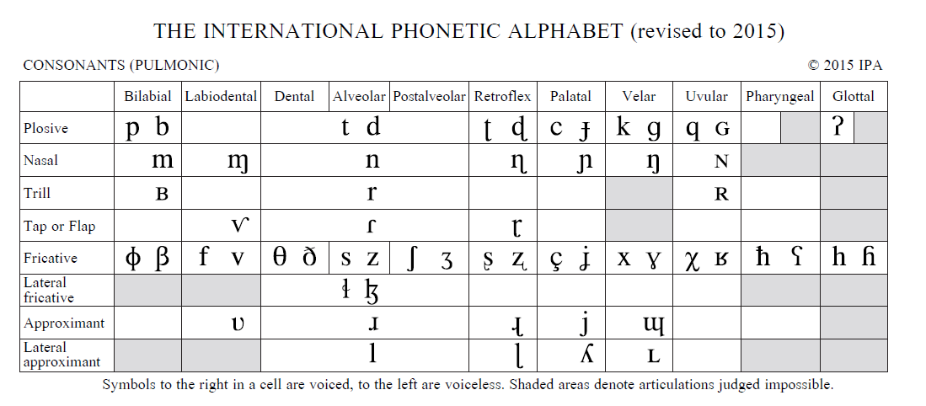
IPA
Notes:
Phonetic alphabat described the way we pro
set of symbols that linguists use to describe the sounds of spoken languages
Places to

Slide 32
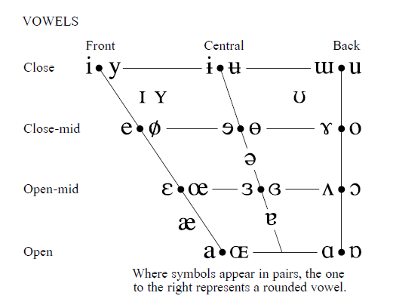
IPA

Slide 33
IPA for Sinhala and Tamil
Consonants
Sound | IPA | Sound | IPA | Sound | IPA
ක/ඛ/க | k | ත/ථ/த | t | ල/ළ/ல | l
ග/ඝ/க | g | ද/ධ/த | d | ව/வ | w
ඟ | g̃ | ඳ | d̃ | ස/ச | s
ච/ඡ | c | ප/ඵ/ப | p | හ/க | h
ජ/ඣ | ɟ | බ/භ/ப | b | ශ/ෂ/ஶ | ʃ/ʂ
ට/ඨ/ட | ʈ | ම/ம | m | ෆ/ஃப் | f
ඩ/ඪ/ட | ɖ | ඹ | b̃ | ඞ/ං/ங | ŋ
ඬ | ɖ̃ | ය/ய | j | ඤ/ஞ | ɲ
න/ණ/ன | n | ර/ர/ற | r | ள | ɭ
ண | ɳ | ந | n̪
Vowels
Sound | IPA | Sound | IPA
අ/அ | a | ආ/ஆ | a:
ඇ | æ | ඈ | æ:
ඉ/இ | i | ඊ/ஈ | i:
උ/உ | u | ඌ/ஊ | u:
එ/எ | e | ඒ/ஏ | e:
ඔ/ஒ | o | ඕ/ஓ | o:
schwa | Ə |  | Ə:
https://en.wikipedia.org/wiki/Help:IPA/Tamil
Notes:
Student Full Name and Address

Slide 34
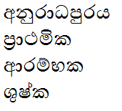

IPA for Sinhala
Exercise:
அனுரதபுரம்
முதன்மை

Slide 35
IPA for Sinhala
Exercise:
[anura:dƏpurƏjƏ]
[pra:tƏmikƏ]
[a:rambƏkƏ]
[ʃuʃkƏ]
[kruti]
[ʃruti]

Slide 36
Types of Phonetics
Articulatory Phonetics
Acoustic Phonetics
Auditory/Perceptual phonetics

Slide 37
1. Articulatory Phonetics
Depending on the generated idea, our brain starts sending messages to articulators, to produce different sounds. The study of this process is known as Articulatory Phonetics
articulators:
In speech production, the moveable and non-moveable structures used to produce speech sounds (tongue, lips, jaw, palate).

Slide 38
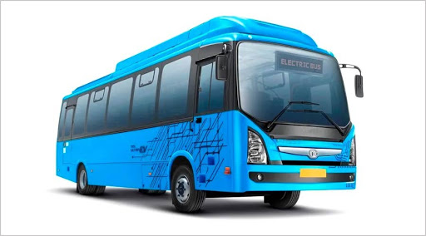
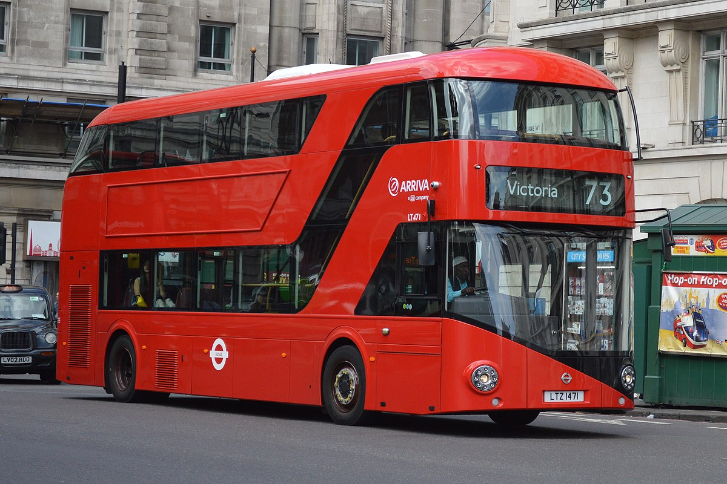
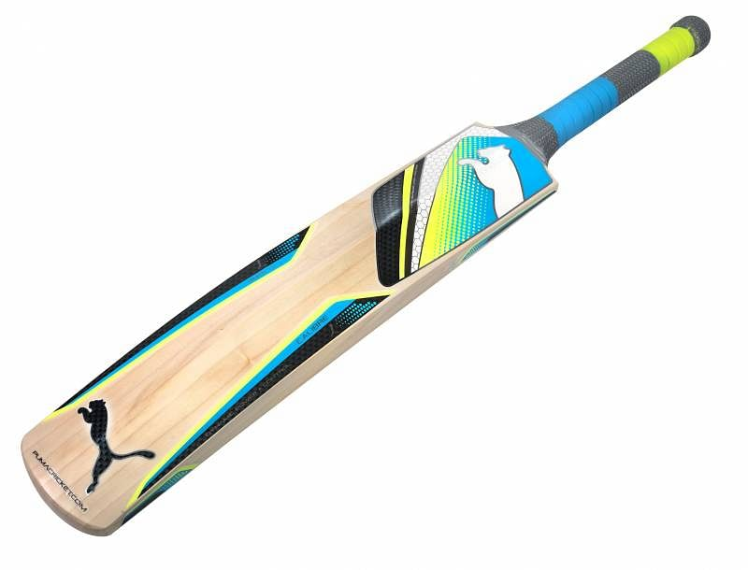
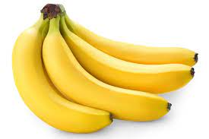

Slide 39
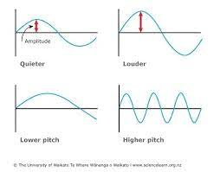
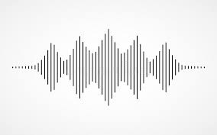
2. Acoustic Phonetics
Once speech is articulated, sound waves are generated. The properties of sound waves are worth studying for Text to Speech (TTS) systems and Automatic Speech Recognition (ASR) systems. This is known as, Acoustic Phonetics

Slide 40
3. Auditory/Perceptual phonetics
It has been found that, what we hear is not exactly what is spoken
Therefore, the study area of what we hear and how we hear is called
Auditory/Perceptual phonetics

Slide 41
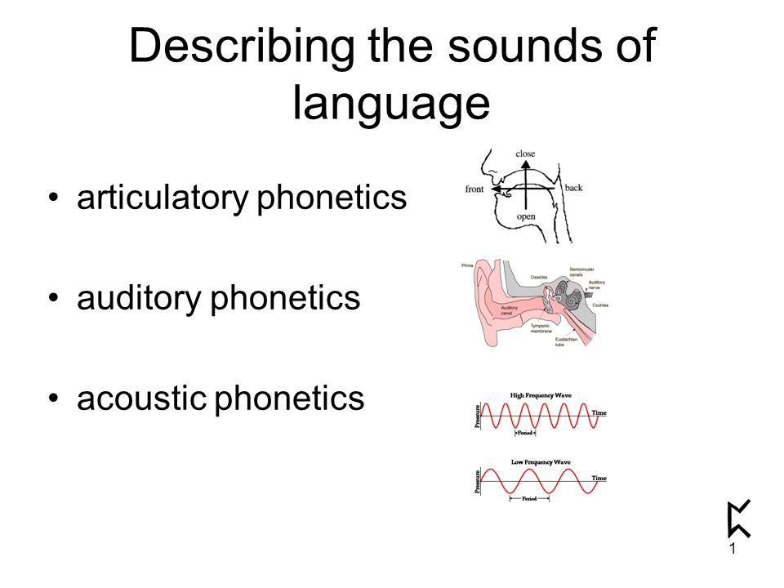

Slide 42
Types of Phonetics
Articulatory Phonetics
Acoustic Phonetics
Auditory/Perceptual phonetics

Slide 43
Articulatory Phonetics
How different articulators interact to create different sounds
Anatomy of Vocal Organs
Consonants
Places of Articulation
Manners of Articulation
Phonation
Vowels

Slide 44
Anatomy of Vocal Organs
Study of how speech sounds are produced by human vocal apparatus

Slide 45
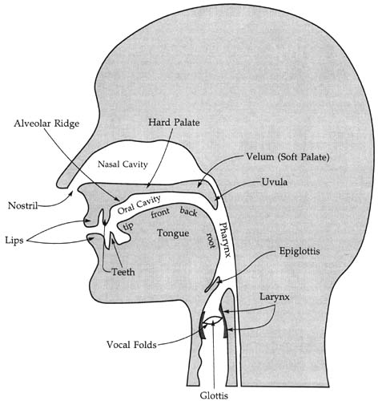
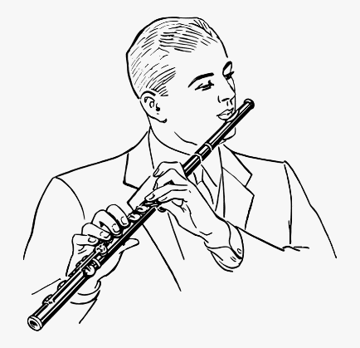
Vocal Tract
The instrument we have to generate sounds!

Slide 46
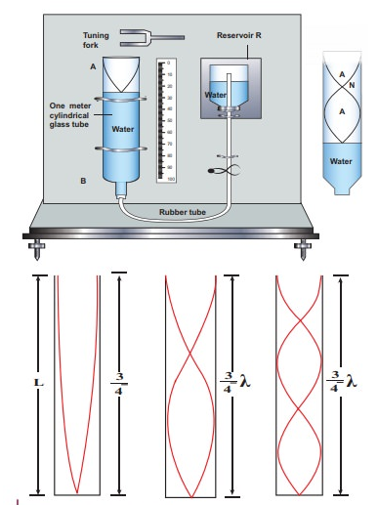
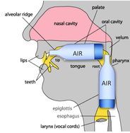
Notes:
If you blow in each of these tubes, which (A,B,C) will produce the highest frequency sound?
අනුනාද resonance

Slide 47
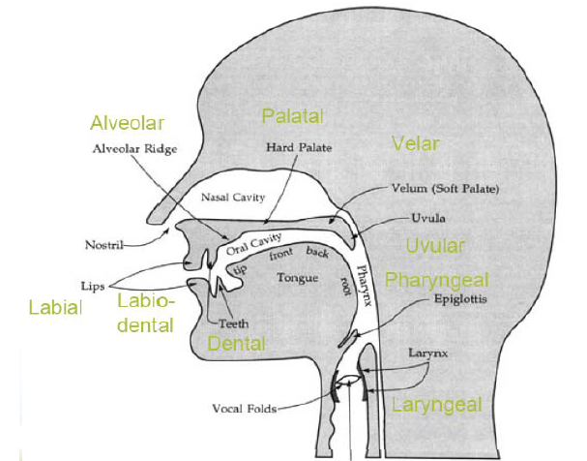
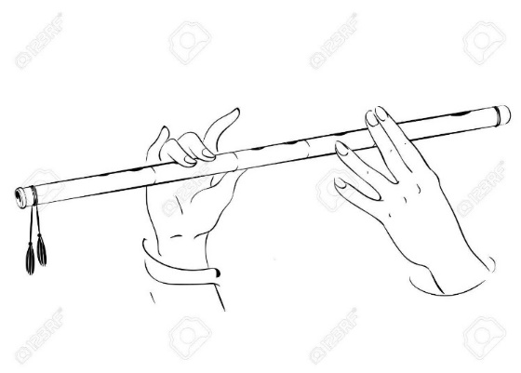
Vocal Tract

Slide 48
Consonants & Vowels
Producing a speech sound involves making the vocal tract narrower at some location than it usually is.
narrowing/making a constriction
Consonants can be said to have a greater degree of constriction than vowels
Notes:
Shrinking or narrowing

Slide 49
Consonants
Which consonant you're pronouncing depends on,
Where the constriction is made in the vocal tract
How narrow it is (the degree of constriction)
To precisely define a consonant,
describe whether the vocal folds are vibrating and whether air is flowing through the nose

Slide 50
Consonants
Consonants can be classified along these three major dimensions:
Place of Articulation
where the narrowing/constriction occurs
Manner of Articulation
how close they get;
how narrow the vocal tract constriction is
Voicing (Phonation)
Vibration of the vocal folds

Slide 51
1. Place of Articulation
Labials
Dental
Alveolar
retroflex
Palatal
Velum
Uvular
Pharynx
laryngeal

Slide 52
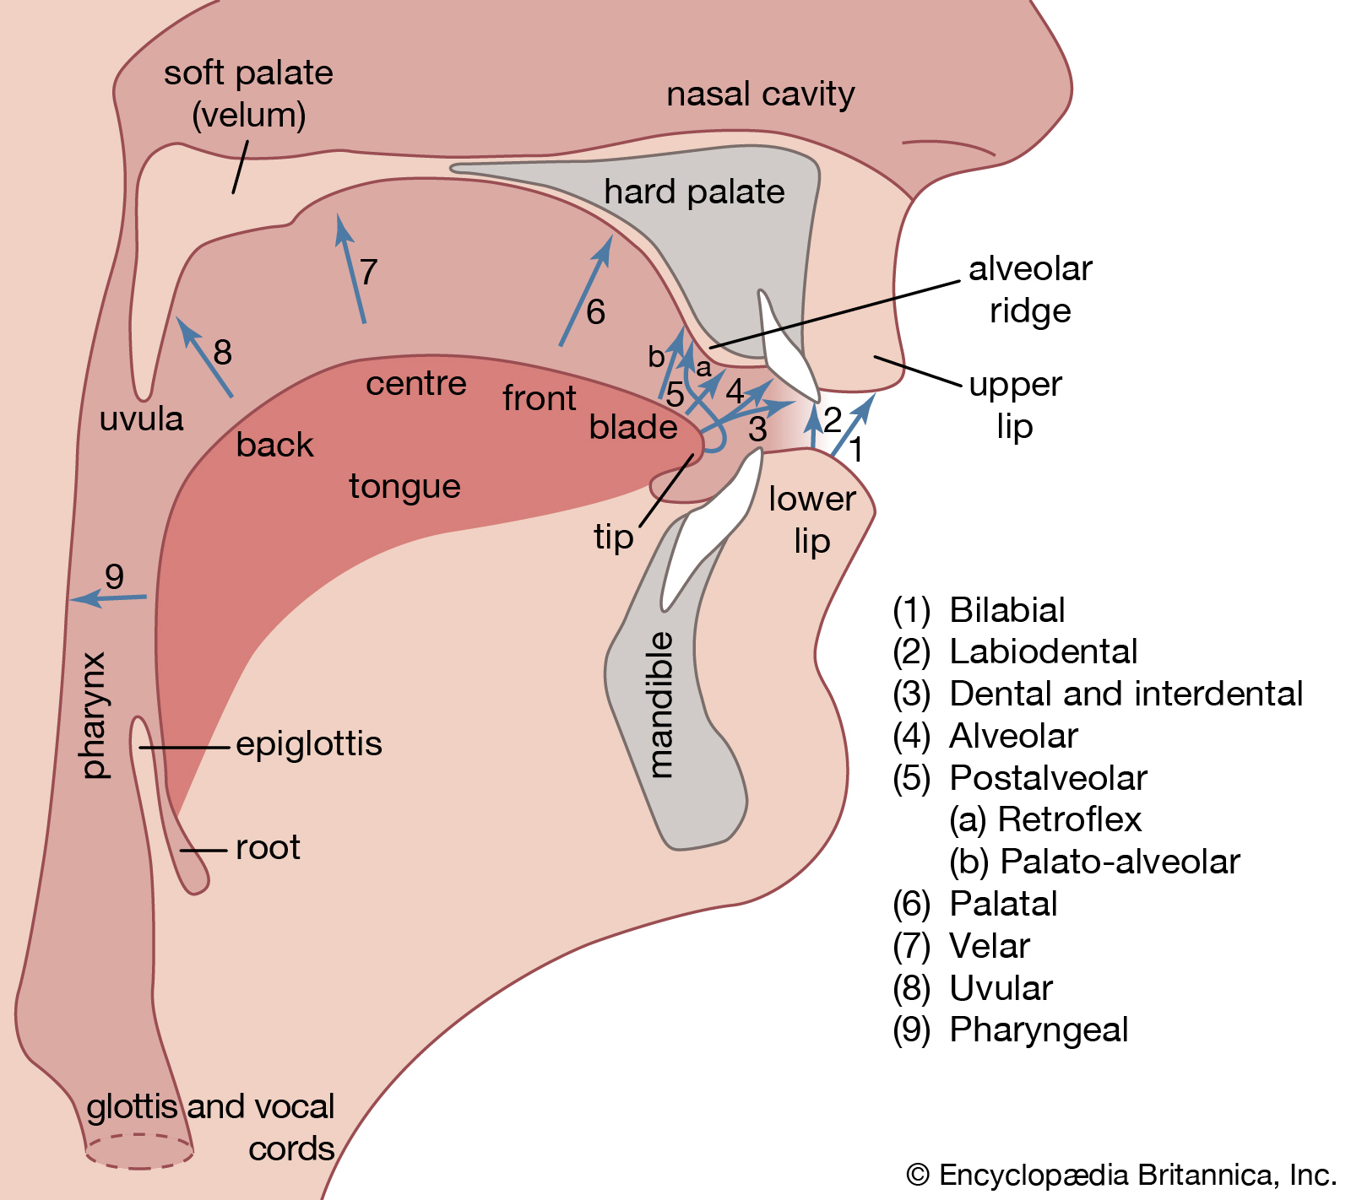

Slide 53
Notes:
completely blocking the flow of air , normally followed by releasing the air. English pronunciation contains 6 plosive phonemes: /p,b,t,d,k,g/:

Slide 54
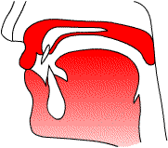
Place of Articulation
Labial
pronounced with active involvement of one or both lips as primary articulators
Bilabials
pronounced with the lips closed or nearly closed
p b m

Slide 55
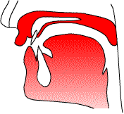
Place of Articulation
Labial
pronounced with active involvement of one or both lips as primary articulators
Bilabials
pronounced with the lips closed or nearly closed
p b m
Labiodentals
pronounced with the lower lip touching the upper teeth
f v

Slide 56
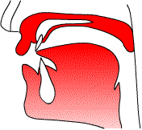
Place of Articulation
Dental
the tip or blade of the tongue approaches or touches the upper teeth
t d l

Slide 57
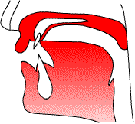
Place of Articulation
Alveolar
the tongue tip/blade approaches or touches the alveolar ridge
n s r

Slide 58
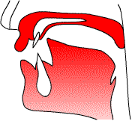
Place of Articulation
Retroflex
pronounced with the tongue tip curled up and back
ʈ ɖ

Slide 59
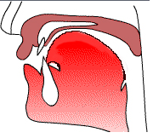
Place of Articulation
Palatal
pronounced with the blade of the tongue against or near the hard palate of the mouth
c ɟ j
Notes:
Cha, ja, ya

Slide 60
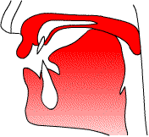
Place of Articulation
Velar
the body of the tongue approaches or touches the soft palate, or velum
k g

Slide 61
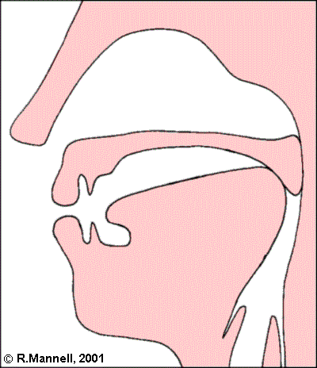
Place of Articulation
Uvular
tongue body is raised far enough back to approach the soft palate near the uvula
q G N

Slide 62
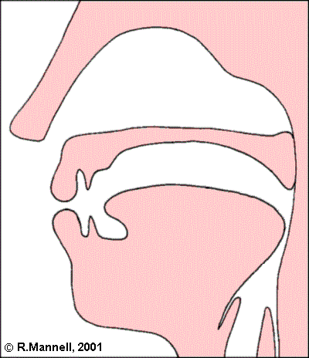
Place of Articulation
Pharynx
Root of the tongue is retracted towards the back wall of the pharynx
ħ

Slide 63
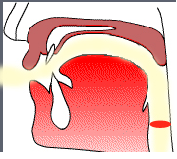
Place of Articulation
Larynx / Glottal
Formed by a constriction in the glottis
h

Slide 64
https://www.mimicmethod.com/ft101/place-of-articulation/
https://seeingspeech.ac.uk/

Slide 65
Consonants
Consonants can be classified along these three major dimensions:
Place of Articulation
where the narrowing/constriction occurs
Manner of Articulation
how close they get;
how narrow the vocal tract constriction is
Voicing (Phonation)
Vibration of the vocal folds

Slide 66
2. Manner of Articulation
Completely Closed – Stops /occlusive/ Plosive
Slightly Open – Fricatives
Slightly More Open – Affricates
Open – Approximants

Slide 68
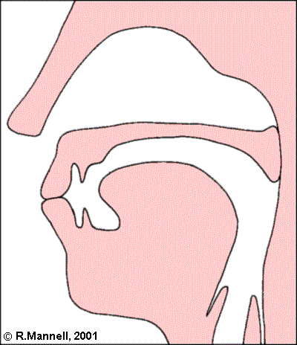
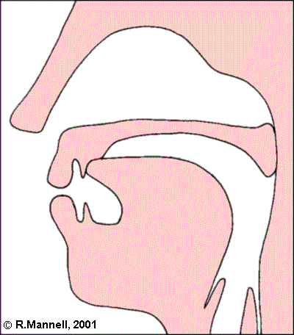
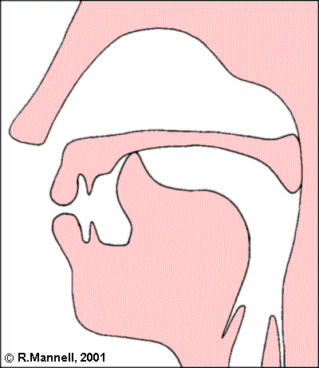
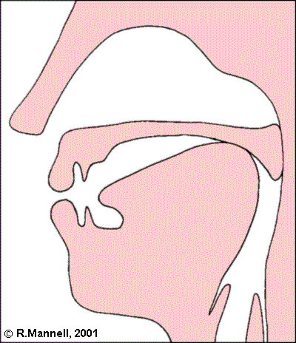
Manner of Articulation
Completely Closed – Stops
Complete blockage of ORAL tract
Oral Stops (Plosives)
the air-stream being stopped in the oral cavity and the soft palate is raised blocking off the nasal cavity
Bilabial-stops Dental-stops Retroflex-stops Velar-stops
p b t d ʈ ɖ k g

Slide 69
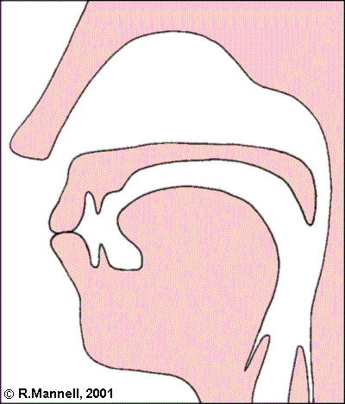
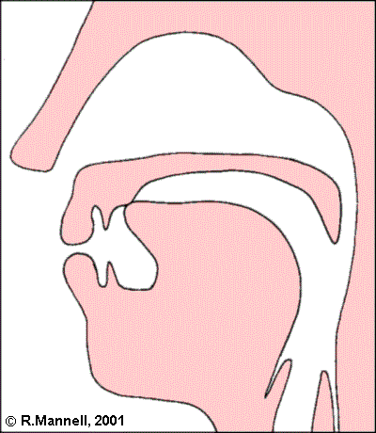
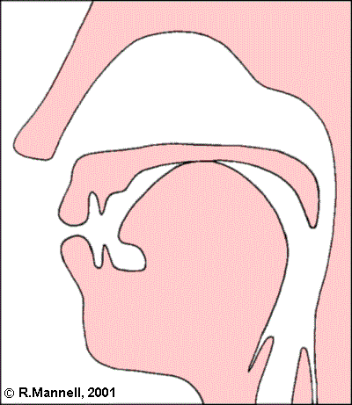
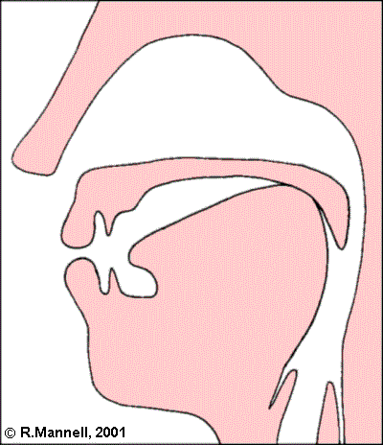
Manner of Articulation
Completely Closed – Stops
Complete blockage of ORAL tract
Nasal Stops
the air- stream being stopped in the oral cavity but the soft palate is down so that the air can go out through the nose
Bilabial-stops Alveolar-stops Palatal-stops Velar-stops
m n ɲ ŋ

Slide 70
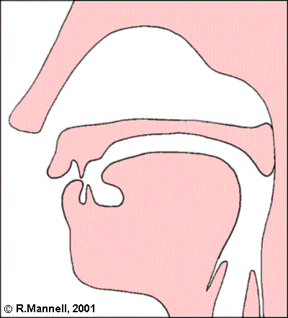
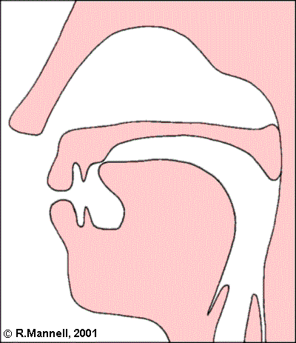
Manner of Articulation
Slightly Open – Fricatives
articulators come close together, but there is a slight gap between them
Labiodentals Alveolar
f s

Slide 71
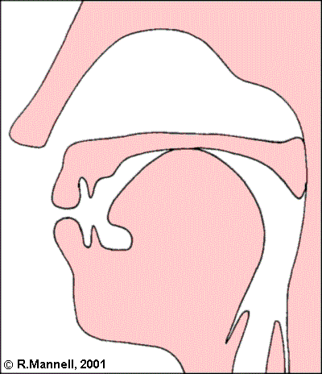
Manner of Articulation
Slightly More Open – Affricates
Starts with a stop, and release like a fricative
Palatal
c ɟ

Slide 72
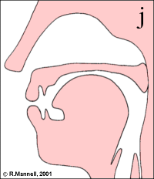
Manner of Articulation
Open – Approximants
the air flows smoothly through the vocal apparatus
Palatal
j

Slide 73
Consonants
Consonants can be classified along these three major dimensions:
Place of Articulation
where the narrowing/constriction occurs
Manner of Articulation
how close they get;
how narrow the vocal tract constriction is
Voicing (Phonation)
Vibration of the vocal folds

Slide 74
3. Voicing (Phonation)
Voiced consonants: are produced when the vocal cords are vibrating
Voiceless consonants: are produced when the vocal cords are not vibrating
Voiceless Voiced
s z

Slide 75
Voicing (Phonation)
Voiceless | Voiced
[k] come | [g] gum
[f] fat | [v] vat
[p] pit | [b] bit
[s] sip | [z] zip
[t] ton | [d] done

Slide 76
Articulatory Phonetics
Place of Articulation
Manner of Articulation
Completely Closed – Stops
Slightly Open – Fricatives
Slightly More Open – Affricates
Open – Approximants
Palatal
Velar
Alveolar
Labial
Dental

Slide 77
Articulatory Phonetics
Identify the Place and Manner of articulation of the following sounds
/s/
/n/
/f/
/t/
/j/
/g/

Slide 78
Articulatory Phonetics
Identify the Place and Manner of articulation of the following sounds
Place Manner
/s/
/n/
/f/
/t/
/j/
/g/
alveolar
alveolar
Labio-dental
dental
palatal
Velar
fricative
nasal-stop
fricative
oral-stop
approximant
oral-stop

Slide 79
IPA

Slide 80
Sinhala Alphabet

Slide 81
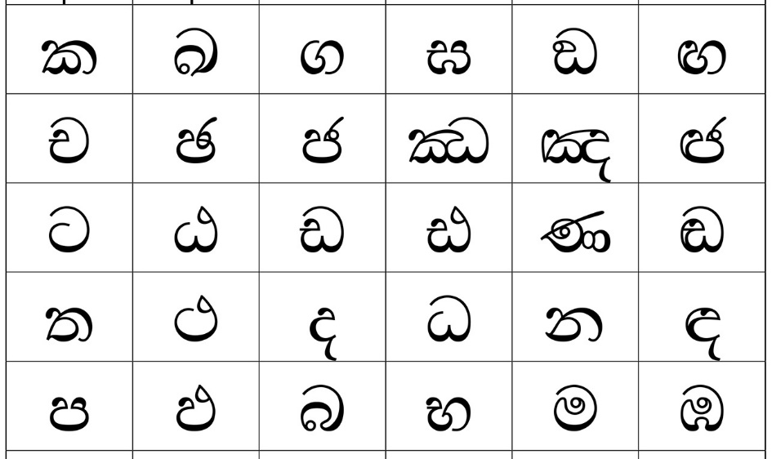
Sinhala Alphabet

Slide 82
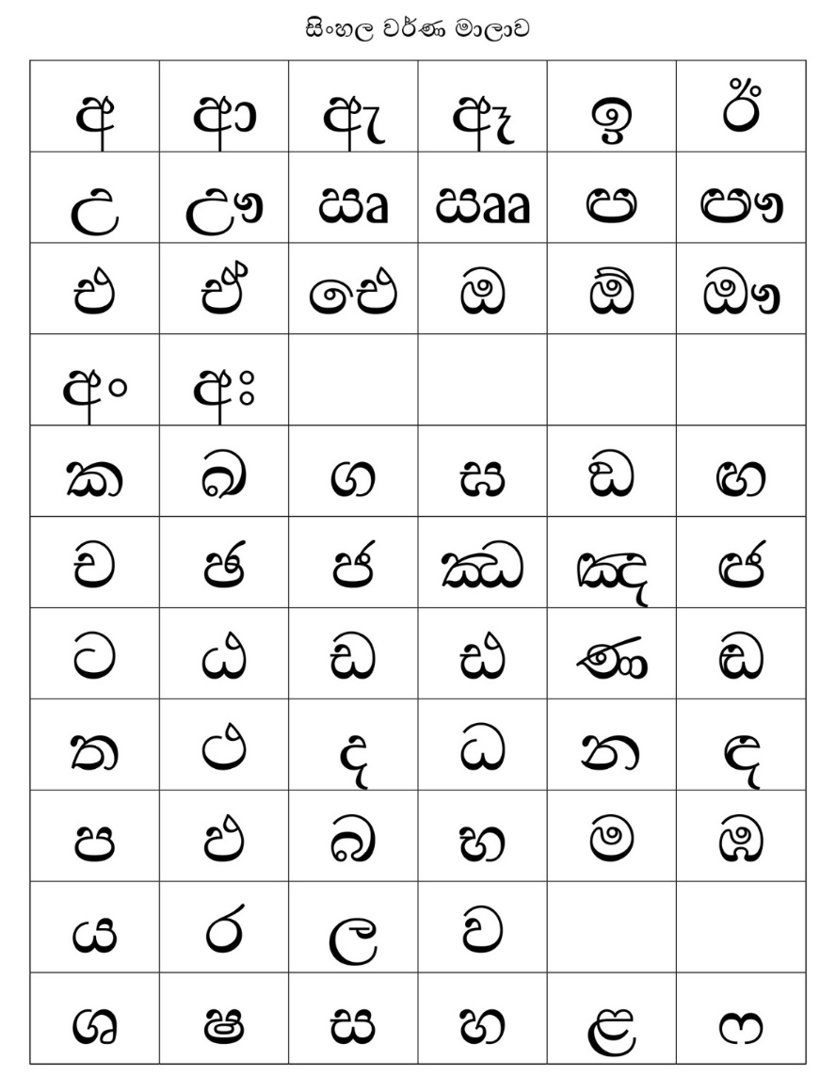
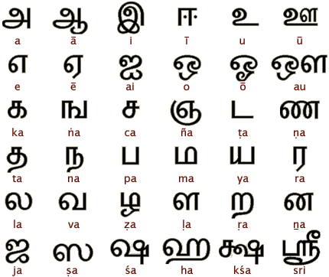
Sinhala and Tamil Alphabets
36 Letters (12 V and 24 C)
60 Letters (20 V and 40 C)
Notes:
Next week ….

Slide 83
Vowels
Monophthongs
One vowel
A monophthong is where there is one vowel sound in a syllable
Dipthongs
Two vowels
A diphthong is where there are two vowel sounds in a syllable.

Slide 84
Syllables
A syllable is a 'unit of pronunciation’.
Mouse (1 syllable)
Rabbit (2 syllables)
Kangaroo (3 syllables)
Barracuda (4 syllables)
Hippopotamus (5 syllables)
Any word must have at least one syllable; even the word ‘a’ has one syllable.
A word has two syllables when there are two vowel sounds divided by a consonant sound, or, to put it another way, two vowel sounds connected by a consonant sound.
A word has three syllables when there are three vowel sounds divided/connected by two consonant sounds.

Slide 85
Vowels
Monophthongs
One vowel
Examples: Funny - a sound and i sound
Dipthongs
Two vowels
Examples: Guy and Behind - /ai/

Slide 86
Vowels
Vowels are open sounds because they involve no obstruction to the flow of air
From lungs as it passes up through the windpipe (trachea), through the voice box (larynx) and out of the mouth
Vowels are made by slight movements of tongue and lip postures
All vowels are produced with the vocal folds vibrating and are said to be voiced sounds.

Slide 87
Vowels
Vowels are commonly described according to the following characteristics:
The portion of the tongue that is involved in the articulation: front, central or back.
The tongue's position relative to the palate: high, mid or low.
The shape of the lips: rounded or unrounded (spread).
The length or duration of vocalization: long or short.

Slide 88
Vowels
Tongue movement
High – Mid – Low /i/ - /e/ - /æ/
Front – Central – Back /i/ - /Ə/ - /u/
Lip postures
Rounded /u:/
Spread /i:/
Neutral /Ə/

Slide 89
IPA

Slide 90
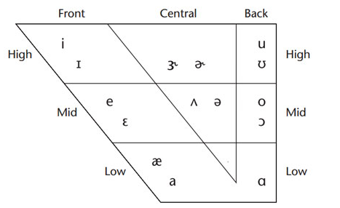
IPA
https://rose-medical.com//vowel-sounds.html

Slide 91
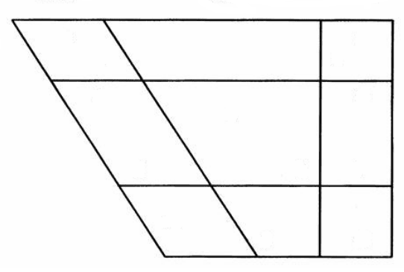
Vowels
Identify Sinhala vowel positions
Vowels
Sound | IPA | Sound | IPA
අ | a | උ | u
ආ | a: | ඌ | u:
ඇ | æ | එ | e
ඈ | æ: | ඒ | e:
ඉ | i | ඔ | o
ඊ | i: | ඕ | o:
schwa | Ə |  | Ə:
Front
Central
Back
High
Mid
Low

Slide 92
Vowels
Front
Central
Back
i
i:
u
u:
High
Mid
e
e:
Ə
Ə:
o
o:
æ
æ:
a
a:
Low

Slide 93
Vowels
Diphthongs
Vowels which have 2 vowel qualities
English: [ai] → eye /ai/
[au] → cow /kau/
Sinhala: [ai] → අයියා /aiya:/
[au] → ඖෂධ /auʃƏdƏ/
[æi] → ඇයි /æi/
Notes:
Importance of learning IPA symbols
Research papers (when you publish research papers and if you show some examples in your language)
Exercise: write your name and your address using IPA

Slide 94
Types of Phonetics
Articulatory Phonetics
Acoustic Phonetics
Auditory/Perceptual phonetics

Slide 95
2. Acoustic Phonetics
Study of the sound waves generated from the articulated speech
study of the acoustic characteristics of speech, including an analysis and description of speech in terms of its physical properties, such as frequency, intensity, and duration
Use of Acoustic Phonetics in NLP
Automatic Speech Recognition (ASR)
Text to Speech Systems (TTS)
Notes:
Buddhi Gamage - -Best Paper Award – ICTer Conference
TTS and OCR – IS Research (Developed Mobile App)

Slide 96
Automatic Speech Recognition (ASR)
ASR (or STT?)
Understanding Speech
Train machines to understand human speech
Speech Recognition (Identify what is being said)
Speaker Recognition (Identify voice/speaker)
Acoustic Model
Model the acoustic (speech) features of a language
Language Model
Model the language (grammar) features of a language

Slide 97
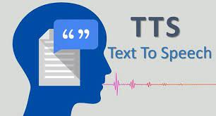
Text To Speech (TTS)
TTS
Generating Speech
Train machines to read text

